Slide 1
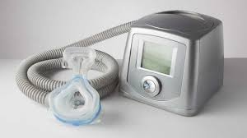
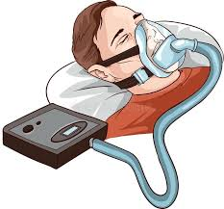
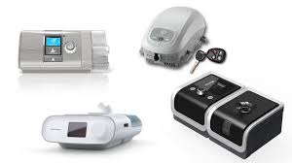
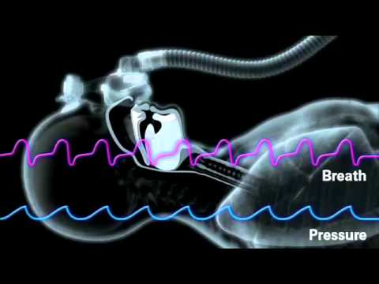
Sleep Apnea And CPAP
Prepared By:
Mohammed Abdo
Asmaa Ibrahim
Sara Younis
Supervised By :
Dr / Mohammed Nagy

Slide 2
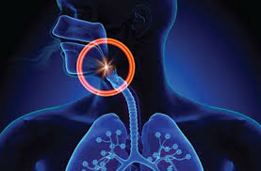
Sleep Apnea

Slide 3
Sleep Apnea
is a sleep-related breathing disorder that involves a decrease or complete halt in airflow despite an ongoing effort to breathe

Slide 4
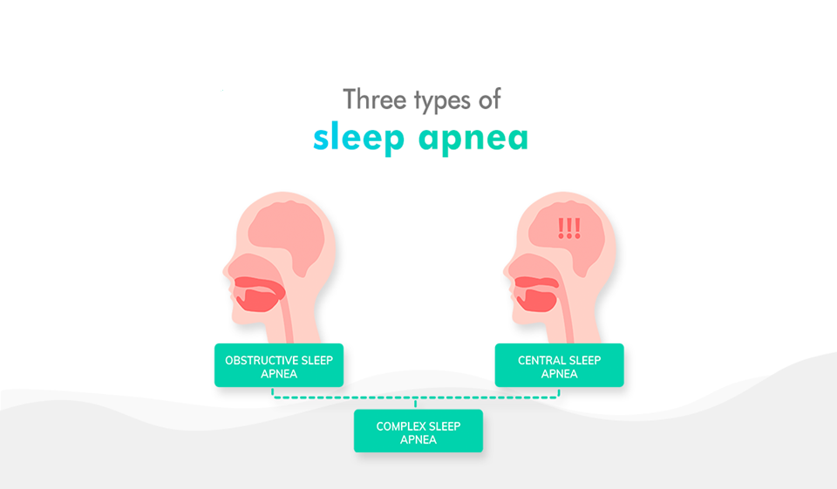

Slide 5
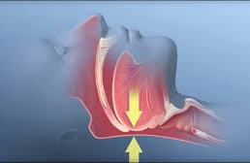
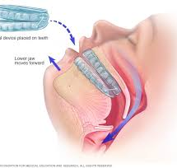
Obstructive Sleep Apnea
(Common type )
Obstructive sleep apnea (OSA) is a sleep-related breathing disorder that involves a decrease or complete halt in airflow despite an ongoing effort to breathe .

Slide 6
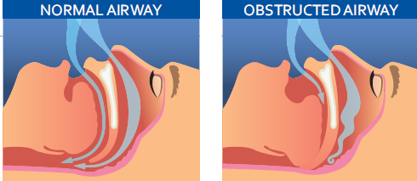
symptoms of obstructive sleep apnea
Common symptoms you may have during sleep:
Gasping or choking sounds.
Breathing pauses observed
by someone watching you sleep.
Frequent awakenings from sleep.
Restless tossing and turning

Slide 7
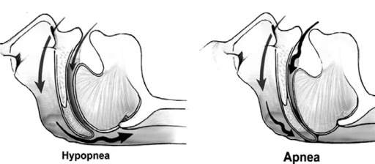
apnea
vs
Hypopnea
Sleep apnea and hypopnea are different versions of the same sleep disorder. An apnea is the complete blockage of air, while hypopnea is the partial blockage of air. Many times, they occur together

Slide 8
Apnea-Hypopnea Index (AHI)
Apnea index (AI) – the number of obstructive and central apneas per hour of sleep.
Apnea-Hypopnea Index (AHI) the number of central and obstructive apnea and hypopneas per hour of sleep.
AHI = sum of the number of apneas (pauses in breathing) plus the number of hypopneas (periods of shallow breathing) occurring, on average, each hour
The duration of Apnea and hypopnea:
Apneas and hypopneas, collectively called events, must last at least 10 seconds to count as events
How to calculate Ahl:
The AHI is calculated by dividing the number of events by the number of hours of sleep

Slide 9
Types of obstructive sleep apnea
AHI of 5-15 - Mild OSA
Involuntary sleepiness during activities that require little attention, such as watching TV or reading
1
AHI of 15-30- Moderate OSA
Involuntary sleepiness during activities that require some attention, such as meetings or presentations
2
AHI of more than 30- Severe OSA
Involuntary sleepiness during activities that require more active attention, such as talking or driving
3

Slide 10
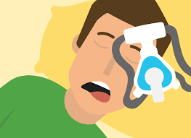
Effects
Fluctuating oxygen levels
Chronic elevation in daytime blood pressure
Increased heart rate
Chronic elevation in daytime blood pressure
Increased risk of stroke
Higher rate of death due to heart disease

Slide 11
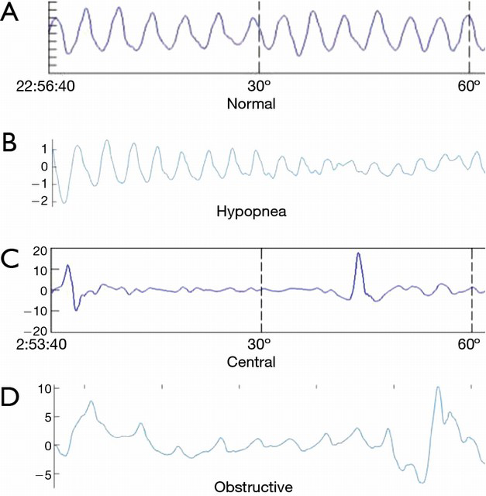
The breathing signal

Slide 12
How to treat obstructive sleep
apnea

Slide 13
Treatments
Sleep apnea must first be diagnosed at a sleep center or lab during an overnight sleep study, or “polysomnogram.”
(CPAP)
Oral appliances
Surgery
Position Therapy
Over-the-counter remedies
Behavioral changes

Slide 14
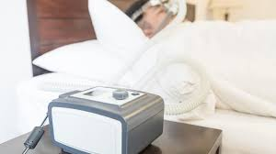
CPAP Machines

Slide 15
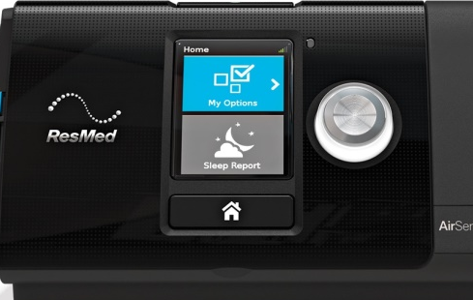
CPAP
Introduction
For the millions of peoples that are affected by sleep apnea or even COPD, their CPAP or Bi-level Positive Airway Pressure systems are important to them.
Obstructive sleep apnea can lead to major health problems that include high blood pressure, heart problems, and have an overall negative impact on our well-being
Those suffering from obstructive sleep apnea (OSA) have problems with breathing and sleeping every night. The best way to treat sleep apnea or COPD is continuous positive airway pressure therapy or CPAP .
CPAP is used to treat mild, moderate and even severe cases of sleep apnea

Slide 16
Uses
2
3
4
1
3
CPAP units are commonly used to provide breathing assistance to patients with obstructive sleep apnea (OSA) or sleep apnea .
CPAP also may be used to treat pre-term infants whose lungs have not yet fully developed
The primary symptom is daytime sleepiness, and it is thought to be a cause of premature death.
use CPAP in infants with respiratory distress syndrome. It is associated with a decrease in the incidence of bronchopulmonary dysplasia.
2

Slide 17
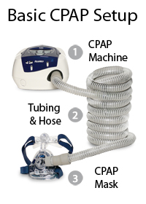

Component
a flow generator or “blower”
tight-fitting face mask
a length of tubing
nasal mask or nasal nares

Slide 18
CPAP Working Machine
CPAP therapy uses machines specifically designed to deliver a constant flow of pressure. Some CPAP machines have other features as well, such as heated humidifiers.
CPAP is the most effective treatment for obstructive sleep apnea, in which the mild pressure from the CPAP prevents the airway from collapsing or becoming blocked. It is an alternative to positive end-expiratory pressure (PEEP).
Both modalities stent the lungs' alveoli open and thus recruit more of the lung's surface area for ventilation, but, while PEEP refers to devices that impose positive pressure only at the end of the exhalation, CPAP devices apply continuous positive airway pressure throughout the breathing cycle.
Thus, the ventilator itself does not cycle during CPAP, no additional pressure above the level of CPAP is provided and patients must initiate all of their breaths

Slide 19
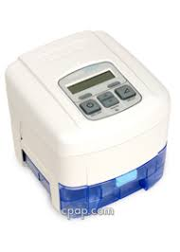
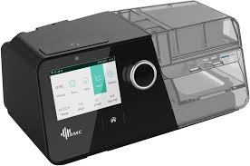
CPAP Modes
i. CPAP
ii. APAP
iii. ASV
iv. AVAPS
Continuous Positive Airway Pressure
the CPAP Machine emits a constant stream of air set to a chosen pressure level.
Automatic Airway Pressure
APAP is automated to work within a pre-set pressure range
Adaptive Servo-Ventilation
ASV provides support to regular breathing by detecting reductions and responding with just enough added pressure to maintain the patient’s breathing at their established baseline
automatically adjusts pressure based on variations in inspiratory airflow to ensure a fixed target volume
Add Text
You can simply impress your audience and add a unique zing and appeal to your Presentations. Get a modern PowerPoint Presentation that is beautifully designed. Easy to change colors, photos and Text.

Slide 20
CPAP Modes
Mode Terms
S (Spontaneous) Mode: In Spontaneous Mode the device will initiate IPAP spontaneously when flow sensors detect inspiratory changes.
v. BIPAP
vi. BiPAP S/T
Bi-level Positive Airway Pressure
a BiPAP machine offers two levels of airway pressure, so you can have two different settings
BIPAP for example your inspiratory setting, or the pressure level at which you inhale (called IPAP) can be set at a higher pressure than the pressure at which you exhale, a.k.a. your expiratory pressure setting (EPAP).
BiLevel Positive Airway Pressure Spontaneous/Timed Therapy
The Spontaneous/Timed designation refers to mode options which allow for more complex algorithms to initiate pressure changes.
BiPAP S/T will initiate inhalation by triggering IPAP either spontaneously or at fixed time intervals, depending on the settings.
T (Timed) Mode: Timed Mode refers to the timing of IPAP/EPAP intervals, meaning that each cycle is initiated by the machine, typically expressed in breaths per minute (BPM).
S/T (Spontaneous/Timed)
n spontaneous/timed mode a "backup" rate is also set to ensure that patients still receive a minimum number of breaths per minute if they fail to breathe spontaneously. :
You can simply impress your audience and add a unique zing and appeal to your Presentations. Get a modern PowerPoint Presentation that is beautifully designed.

Slide 21
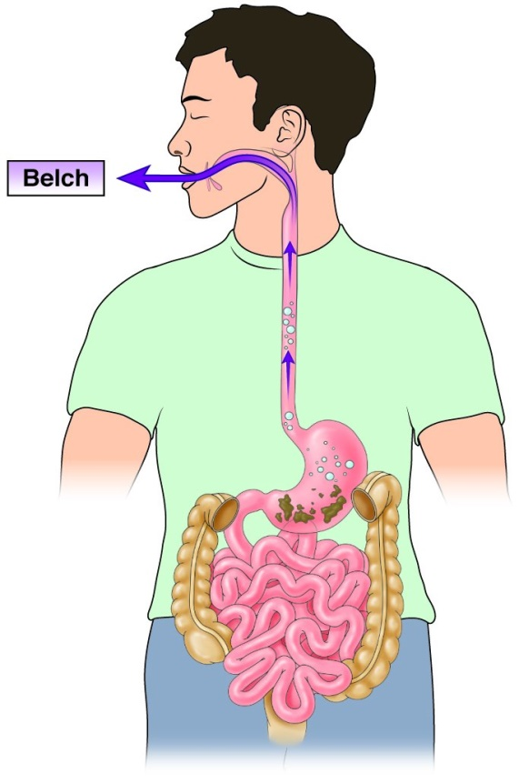
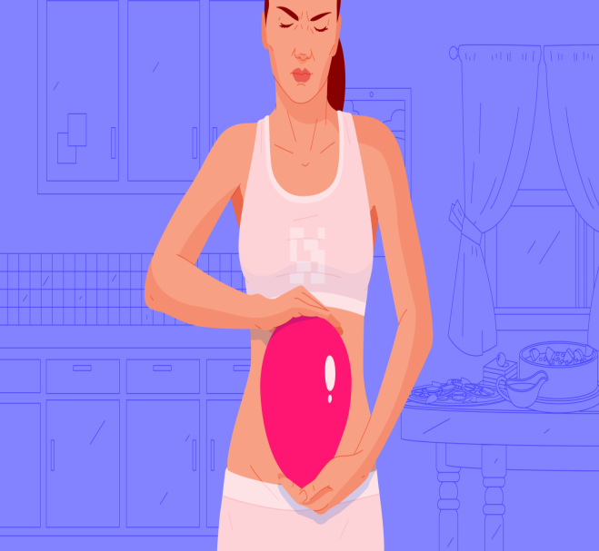
Complications
Swallowing of air into the .stomach may occur

Slide 22
THANK YOU

